Slide 1
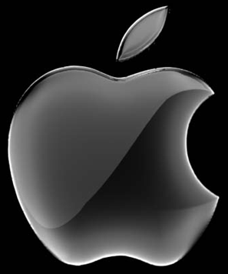


Slide 2
Agenda
iPhone
Android Phones
Comparison
History
Conclusion

Slide 3
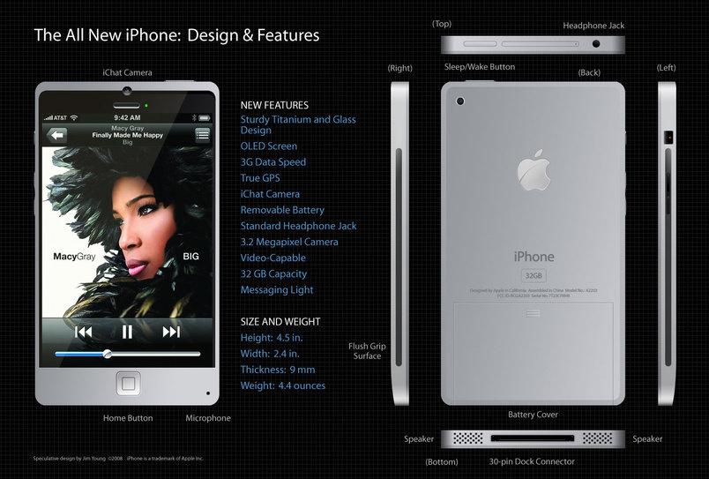
iPhone

Slide 4
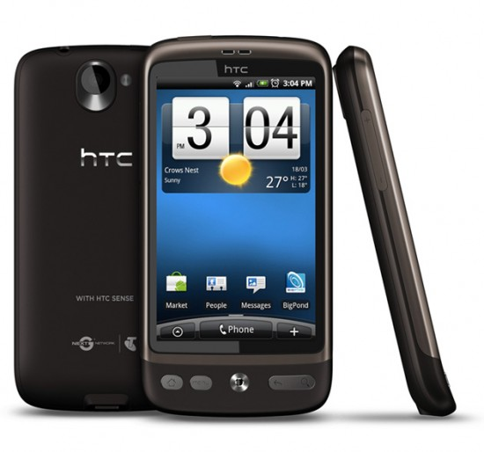
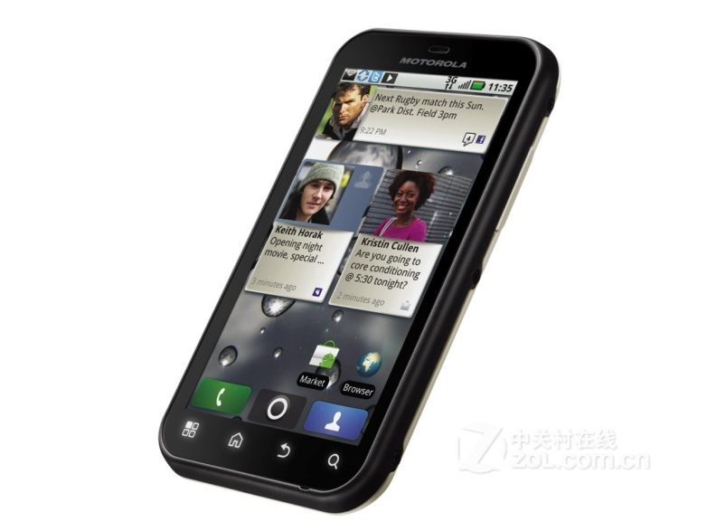
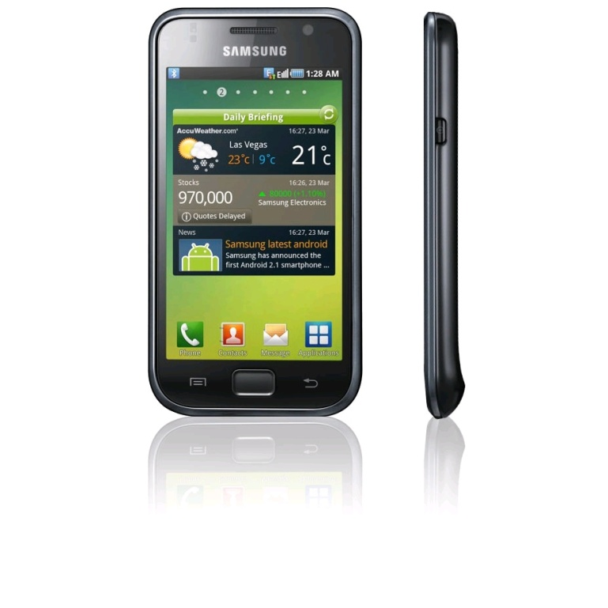
Android Phones

Slide 5
Comparison
Multiplayer
Open world
Chaos
Free
Single player
Closed world
Unified
Restricted

Slide 6
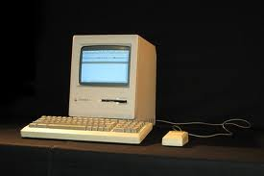
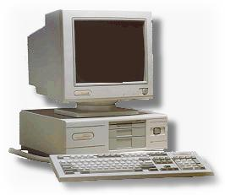
History

Slide 7
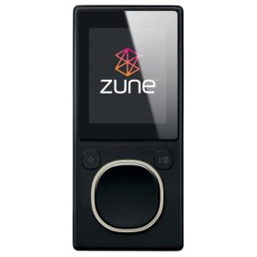
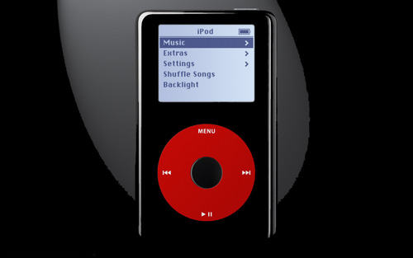
History

Slide 8
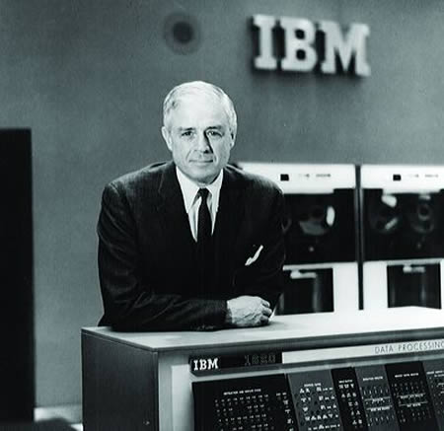
Conclusion
I think there is a world market for maybe five computers.

Slide 9
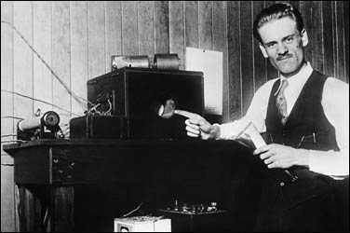
Conclusion
There is no reason anyone would want a computer in their home.

Slide 10
Conclusion
NO CONCLUSION. ☺

